Slide 1
Cluster Analysis: Basic Concepts and Algorithms

Slide 2
What is Cluster Analysis?
Given a set of objects, place them in groups such that the objects in a group are similar (or related) to one another and different from (or unrelated to) the objects in other groups
Inter-cluster distances are maximized
Intra-cluster distances are minimized

Slide 3
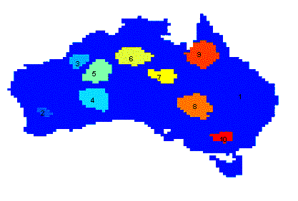
Applications of Cluster Analysis
Understanding
  Group related documents for browsing, group genes and proteins that have similar functionality, or group stocks with similar price fluctuations
Summarization
  Reduce the size of large data sets
Clustering precipitation in Australia

Slide 4
Notion of a Cluster can be Ambiguous
How many clusters?
Six Clusters
Two Clusters
Four Clusters

Slide 5
Types of Clusterings
A clustering is a set of clusters
Important distinction between hierarchical and partitional sets of clusters
  Partitional Clustering
    A division of data objects into non-overlapping subsets (clusters)
  Hierarchical clustering
    A set of nested clusters organized as a hierarchical tree

Slide 6
Partitional Clustering
Original Points
A Partitional Clustering

Slide 7
Hierarchical Clustering
Traditional Hierarchical Clustering
Traditional Dendrogram
Non-traditional Hierarchical Clustering
Non-traditional Dendrogram

Slide 8
Characteristics of the Input Data Are Important
Type of proximity or density measure
  Central to clustering
  Depends on data and application
Data characteristics that affect proximity and/or density are
  Dimensionality
    Sparseness
  Attribute type
  Special relationships in the data
    For example, autocorrelation
  Distribution of the data
Noise and Outliers
  Often interfere with the operation of the clustering algorithm
Clusters of differing sizes, densities, and shapes

Slide 9
Clustering Algorithms
K-means and its variants
Hierarchical clustering
Density-based clustering

Slide 10
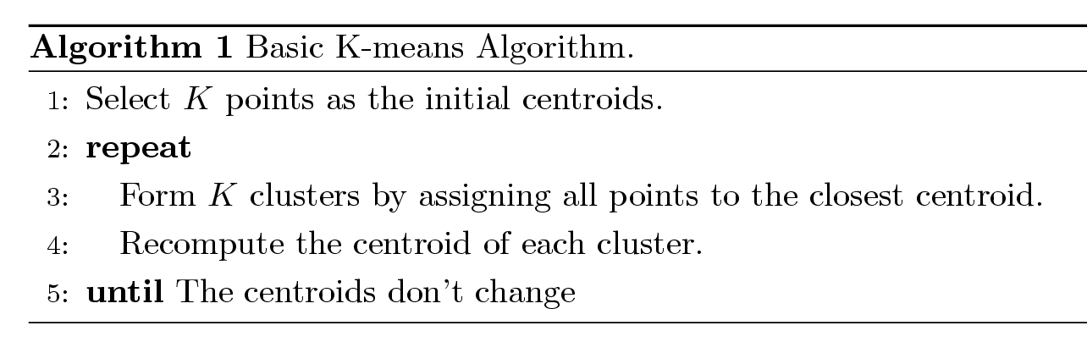
K-means Clustering
Partitional clustering approach
Number of clusters, K, must be specified
Each cluster is associated with a centroid (center point)
Each point is assigned to the cluster with the closest centroid
The basic algorithm is very simple

Slide 11
Example of K-means Clustering

Slide 12
Example of K-means Clustering

Slide 13
K-means Clustering – Details
Simple iterative algorithm.
  Choose initial centroids;
  repeat {assign each point to a nearest centroid; re-compute cluster centroids}
  until centroids stop changing.
Initial centroids are often chosen randomly.
  Clusters produced can vary from one run to another
The centroid is (typically) the mean of the points in the cluster, but other definitions are possible (see Table 7.2).
K-means will converge for common proximity measures with appropriately defined centroid (see Table 7.2)
Most of the convergence happens in the first few iterations.
  Often the stopping condition is changed to ‘Until relatively few points change clusters’
Complexity is O( n * K * I * d )
  n = number of points, K = number of clusters,
  I = number of iterations, d = number of attributes

Slide 14
K-means Objective Function
A common objective function (used with Euclidean distance measure) is Sum of Squared Error (SSE)
  For each point, the error is the distance to the nearest cluster center
  To get SSE, we square these errors and sum them.
  x is a data point in cluster C_{i} and m_{i} is the centroid (mean) for cluster C_{i}
  SSE improves in each iteration of K-means until it reaches a local or global minima.

Slide 15
Two different K-means Clusterings
Original Points
Optimal Clustering
Sub-optimal Clustering

Slide 16
Importance of Choosing Initial Centroids …

Slide 17
Importance of Choosing Initial Centroids …

Slide 18
Solutions to Initial Centroids Problem
Multiple runs
  Helps, but probability is not on your side
Use some strategy to select the k initial centroids and then select among these initial centroids
  Select most widely separated
    K-means++ is a robust way of doing this selection
  Use hierarchical clustering to determine initial centroids
Bisecting K-means
  Not as susceptible to initialization issues

Slide 19
Limitations of K-means
K-means has problems when clusters are of differing
  Sizes
  Densities
  Non-globular shapes
K-means has problems when the data contains outliers.
  One possible solution is to remove outliers before clustering

Slide 20
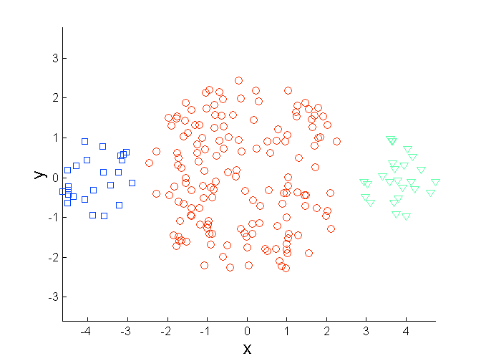
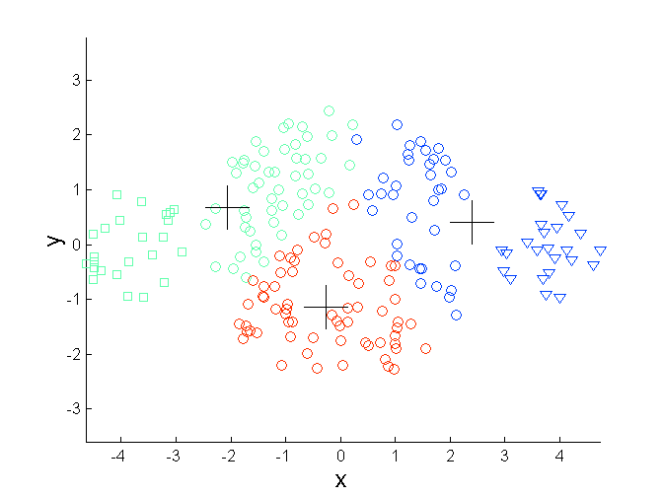
Limitations of K-means: Differing Sizes
Original Points
K-means (3 Clusters)

Slide 21
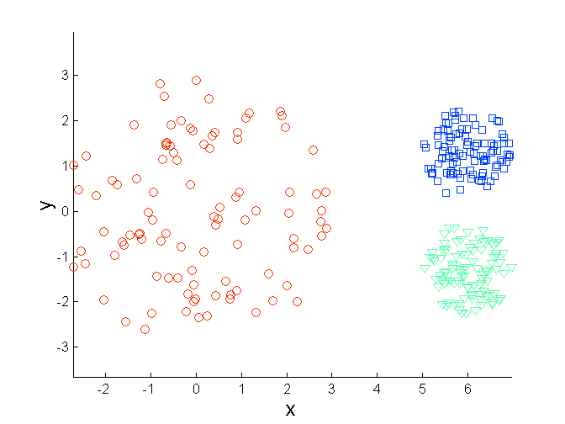
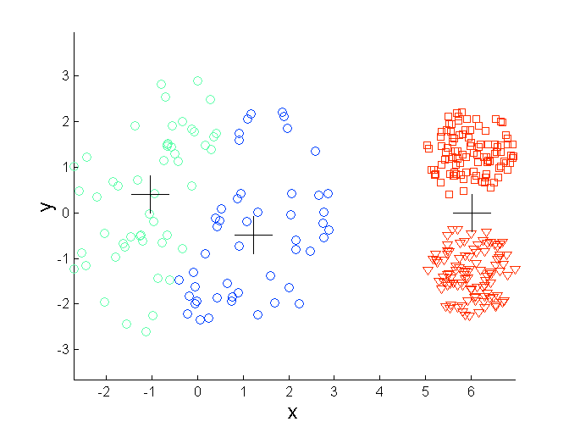
Limitations of K-means: Differing Density
Original Points
K-means (3 Clusters)

Slide 22
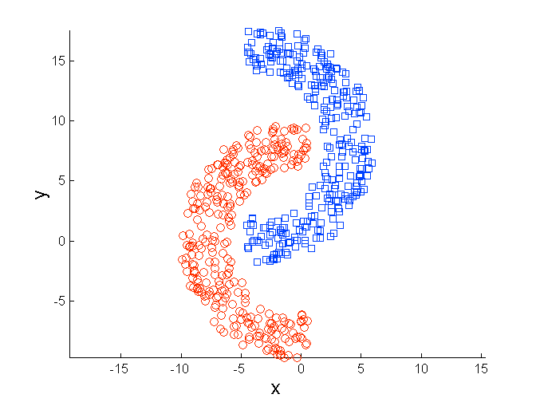
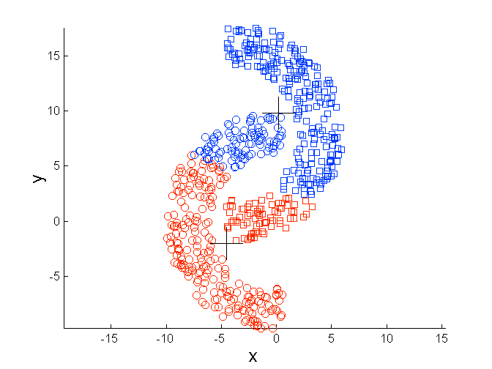
Limitations of K-means: Non-globular Shapes
Original Points
K-means (2 Clusters)

Slide 23
Hierarchical Clustering
Produces a set of nested clusters organized as a hierarchical tree
Can be visualized as a dendrogram
  A tree like diagram that records the sequences of merges or splits

Slide 24
Strengths of Hierarchical Clustering
Do not have to assume any particular number of clusters
  Any desired number of clusters can be obtained by ‘cutting’ the dendrogram at the proper level
They may correspond to meaningful taxonomies
  Example in biological sciences (e.g., animal kingdom, phylogeny reconstruction, …)

Slide 25
Hierarchical Clustering
Two main types of hierarchical clustering
  Agglomerative:
    Start with the points as individual clusters
    At each step, merge the closest pair of clusters until only one cluster (or k clusters) left
  Divisive:
    Start with one, all-inclusive cluster
    At each step, split a cluster until each cluster contains an individual point (or there are k clusters)
Traditional hierarchical algorithms use a similarity or distance matrix
  Merge or split one cluster at a time

Slide 26
Agglomerative Clustering Algorithm
Key Idea: Successively merge closest clusters
Basic algorithm
  Compute the proximity matrix
  Let each data point be a cluster
  Repeat
  Merge the two closest clusters
  Update the proximity matrix
  Until only a single cluster remains
Key operation is the computation of the proximity of two clusters
  Different approaches to defining the distance between clusters distinguish the different algorithms

Slide 27
Steps 1 and 2
Start with clusters of individual points and a proximity matrix
p1
p2
p3
p4
p5
. . .
p1
p2
p3
p4
p5
.
.
.
Proximity Matrix

Slide 28
Intermediate Situation
After some merging steps, we have some clusters
C1
C2
C3
C4
C5
C1
C2
C3
C3
C4
C4
C5
Proximity Matrix
C1
C2
C5

Slide 29
Step 4
We want to merge the two closest clusters (C2 and C5) and update the proximity matrix.
C1
C2
C3
C4
C5
C1
C2
C3
C3
C4
C4
C5
Proximity Matrix
C1
C2
C5

Slide 30
Step 5
The question is “How do we update the proximity matrix?”
C2 U C5
C1
C3
C4
C1
?
C2 U C5
? ? ? ?
C3
C3
?
C4
C4
?
Proximity Matrix
C1
C2 U C5

Slide 31
How to Define Inter-Cluster Distance
p1
p2
p3
p4
p5
. . .
p1
Similarity?
p2
p3
p4
p5
MIN
MAX
Group Average
Distance Between Centroids
Other methods driven by an objective function
  Ward’s Method uses squared error
.
.
.
Proximity Matrix

Slide 32
How to Define Inter-Cluster Similarity
p1
p2
p3
p4
p5
. . .
p1
p2
p3
p4
p5
MIN
MAX
Group Average
Distance Between Centroids
Other methods driven by an objective function
  Ward’s Method uses squared error
.
.
.
Proximity Matrix

Slide 33
How to Define Inter-Cluster Similarity
p1
p2
p3
p4
p5
. . .
p1
p2
p3
p4
p5
MIN
MAX
Group Average
Distance Between Centroids
Other methods driven by an objective function
  Ward’s Method uses squared error
.
.
.
Proximity Matrix

Slide 34
How to Define Inter-Cluster Similarity
p1
p2
p3
p4
p5
. . .
p1
p2
p3
p4
p5
MIN
MAX
Group Average
Distance Between Centroids
Other methods driven by an objective function
  Ward’s Method uses squared error
.
.
.
Proximity Matrix

Slide 35
How to Define Inter-Cluster Similarity
p1
p2
p3
p4
p5
. . .
p1
×
×
p2
p3
p4
p5
MIN
MAX
Group Average
Distance Between Centroids
Other methods driven by an objective function
  Ward’s Method uses squared error
.
.
.
Proximity Matrix

Slide 36
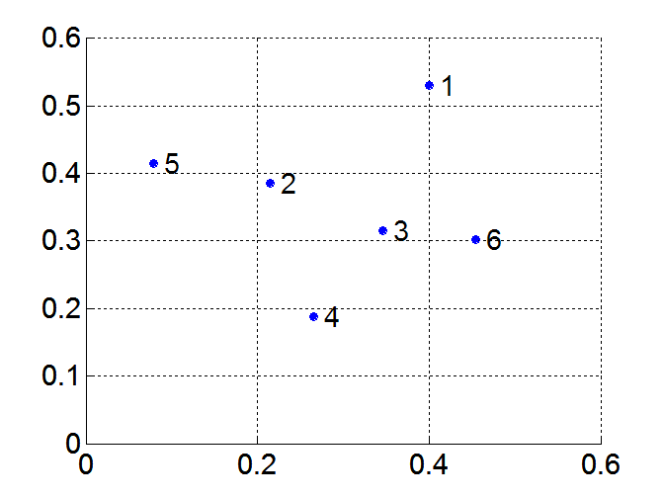
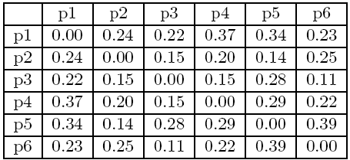
MIN or Single Link
Proximity of two clusters is based on the two closest points in the different clusters
  Determined by one pair of points, i.e., by one link in the proximity graph
Example:
Distance Matrix:

Slide 37
Hierarchical Clustering: MIN
5
1
3
5
2
1
2
3
6
4
4
Nested Clusters
Dendrogram

Slide 38
MAX or Complete Linkage
Proximity of two clusters is based on the two most distant points in the different clusters
  Determined by all pairs of points in the two clusters
Distance Matrix:

Slide 39
Hierarchical Clustering: MAX
4
1
2
5
5
2
3
6
3
1
4
Nested Clusters
Dendrogram

Slide 40
Group Average
Proximity of two clusters is the average of pairwise proximity between points in the two clusters.
Distance Matrix:

Slide 41
Hierarchical Clustering: Group Average
5
4
1
2
5
2
3
6
1
4
3
Nested Clusters
Dendrogram

Slide 42
Hierarchical Clustering: Group Average
Compromise between Single and Complete Link
Strengths
  Less susceptible to noise
Limitations
  Biased towards globular clusters

Slide 43
Hierarchical Clustering: Comparison
5
1
4
1
3
2
5
5
5
2
1
MIN
2
MAX
2
3
6
3
3
6
1
4
4
4
5
5
1
4
1
2
2
5
2
Ward’s Method
5
2
3
6
Group Average
3
3
6
4
1
1
4
4
3

Slide 44
Hierarchical Clustering: Problems and Limitations
Once a decision is made to combine two clusters, it cannot be undone
No global objective function is directly minimized
Different schemes have problems with one or more of the following:
  Sensitivity to noise
  Difficulty handling clusters of different sizes and non-globular shapes
  Breaking large clusters

Slide 45
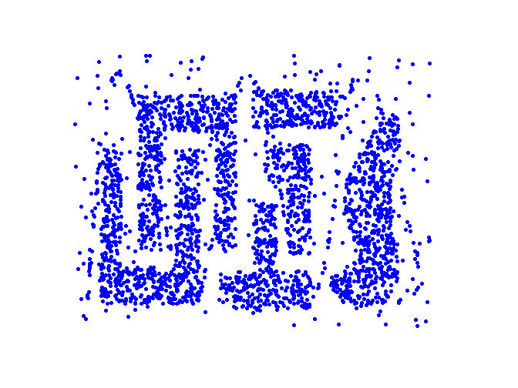
Density Based Clustering
Clusters are regions of high density that are separated from one another by regions on low density.

Slide 46
DBSCAN
DBSCAN is a density-based algorithm.
  Density = number of points within a specified radius (Eps)
  A point is a core point if it has at least a specified number of points (MinPts) within Eps
    These are points that are at the interior of a cluster
    Counts the point itself
  A border point is not a core point, but is in the neighborhood of a core point
  A noise point is any point that is not a core point or a border point

Slide 47
DBSCAN: Core, Border, and Noise Points
MinPts = 7

Slide 48
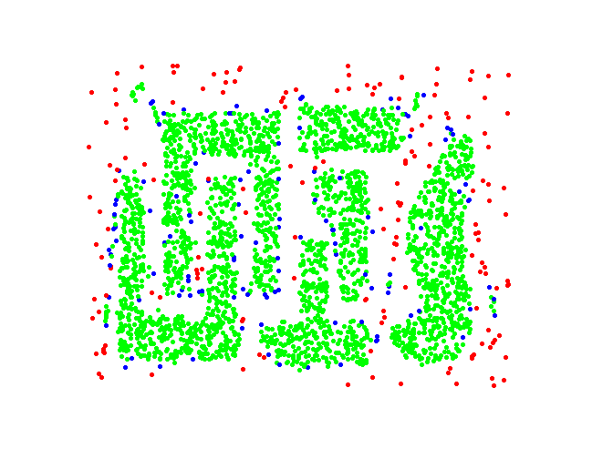
DBSCAN: Core, Border and Noise Points
Original Points
Point types: core, border and noise
Eps = 10, MinPts = 4

Slide 49
DBSCAN Algorithm
Form clusters using core points, and assign border points to one of its neighboring clusters
1: Label all points as core, border, or noise points.
2: Eliminate noise points.
3: Put an edge between all core points within a distance Eps of each other.
4: Make each group of connected core points into a separate cluster.
5: Assign each border point to one of the clusters of its associated core points

Slide 50
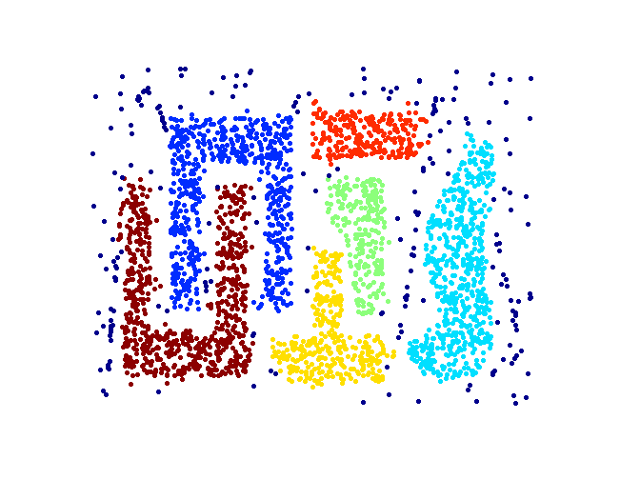
When DBSCAN Works Well
Original Points
Clusters (dark blue points indicate noise)
Can handle clusters of different shapes and sizes
Resistant to noise

Slide 51
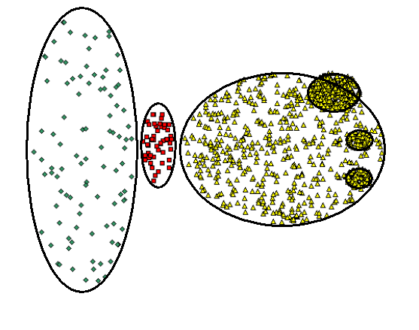
When DBSCAN Does NOT Work Well
Original Points

Slide 52
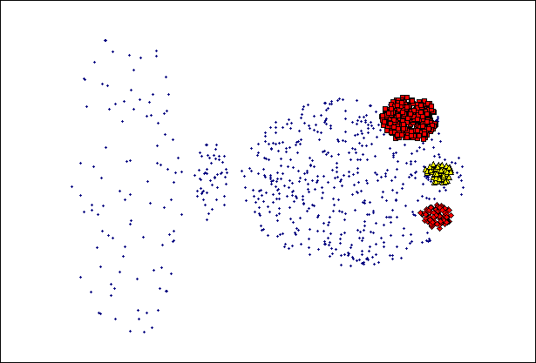
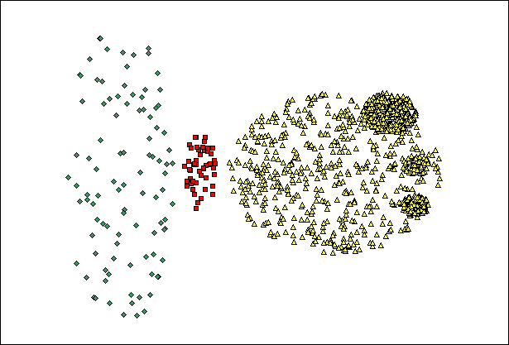
When DBSCAN Does NOT Work Well
(MinPts=4, Eps=9.92).
Original Points
Varying densities
High-dimensional data
(MinPts=4, Eps=9.75)

